Slide 1
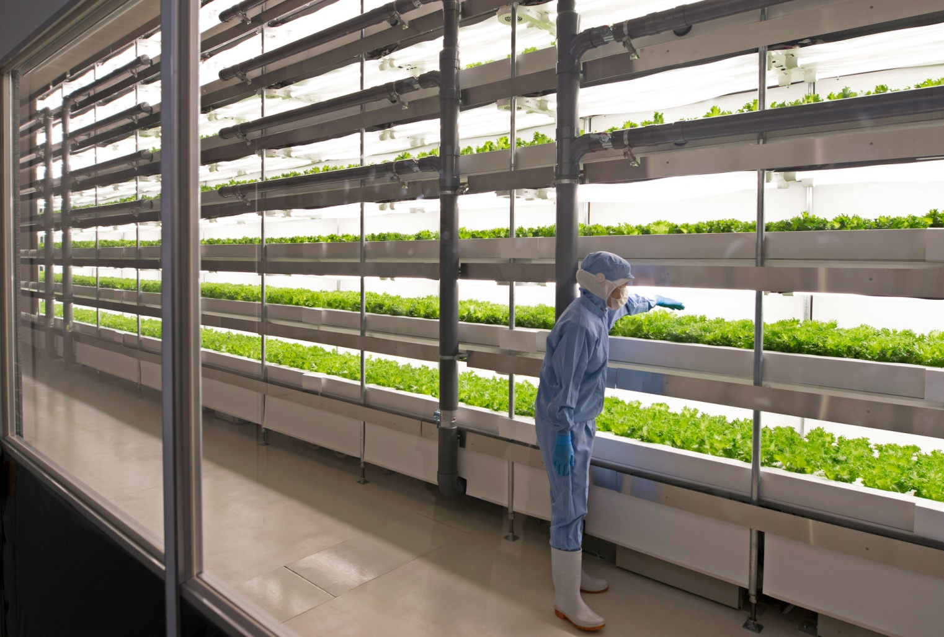
PLANT FACTORY?

Slide 2
In order to feed the world, protect the environment, improve health, and achieve economic growth, a new form of agricultural cultivation is required:
Indoor vertical farming using a system with artificial lighting, thermally insulated and nearly airtight warehouse, Multiple culture shelves, air circulation fans, CO2 and nutrient solution supply units, and an environmental control unit for efficient production of food crops.

Slide 3
Potential advantages over the conventional production system:
It can be built anywhere because neither solar light nor soil is needed;
The growing environment is not affected by the outside climate and soil fertility;
Production can be year-round and productivity is over 100 times that of field production;
Produce quality such as concentrations of phytonutrients can be enhanced through manipulation of the growing environment, especially light quality;
Produce is pesticide-free and need not be washed before eating;
Produce has a longer shelf life because the bacterial load is generally less than 300 CFU/gm which is 1/100 to 1/1000 that of field-grown produce;
Energy for transportation can be reduced by building PFALs near urban areas; and
High resource use efficiency (water, CO2, fertilizer, etc.) can be achieved with minimum emission of pollutants to the outside environment.

Slide 4
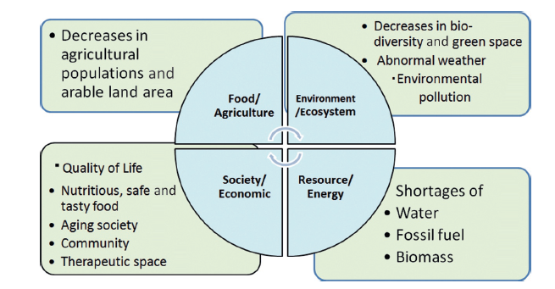
Plant Factory : Need in Urban area

Slide 5
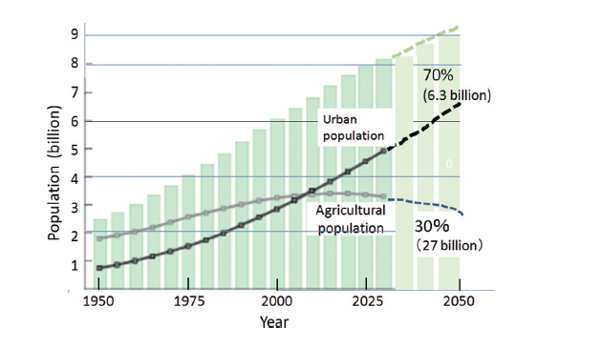
Trend of world population, Agricultural Population

Slide 6
Factors affecting Plant growth in climate control chamber
Availbility of water
Availability of CO2
Avalability of Light
Rate of Photosynthesis
Rate of Transpiration
Electricity/Cooling cost

Slide 7
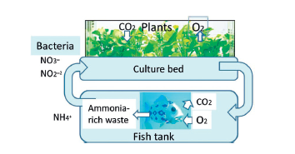
Model Ecosystem connected with other Biosystems

Slide 8
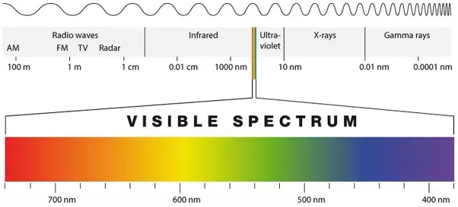
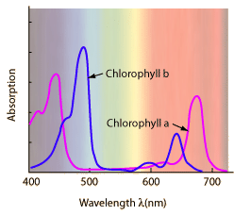
LED light: more energy efficient to carry out photosynthesis

Slide 9
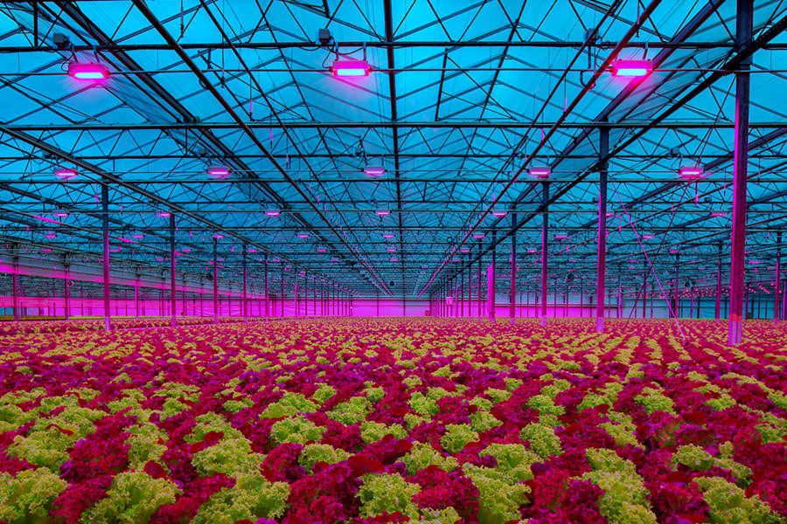
Use of energy efficient LED in Plant Factory

Slide 10
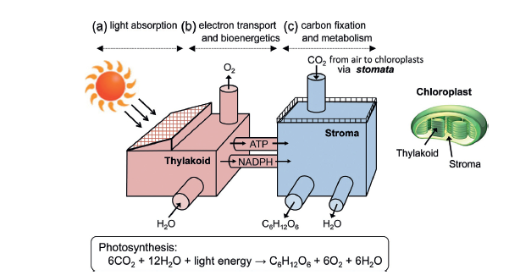

Slide 11
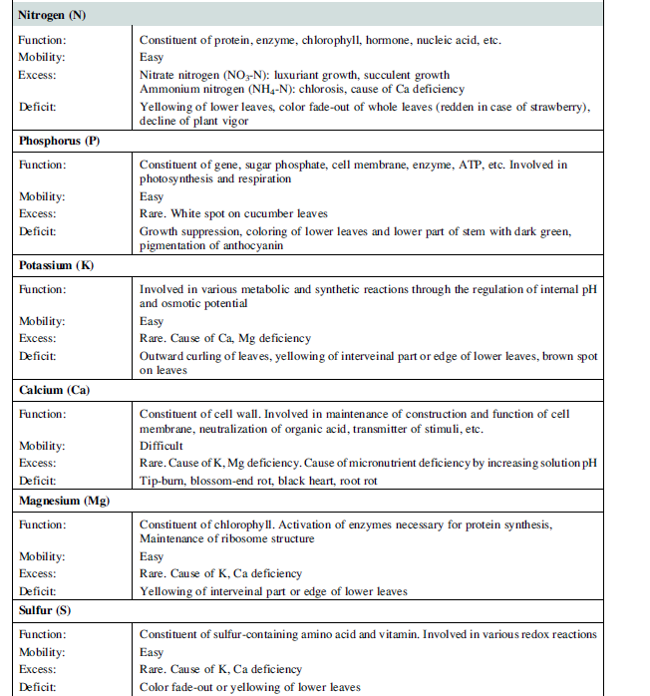
Elements/Nutrients for Plant growth

Slide 13
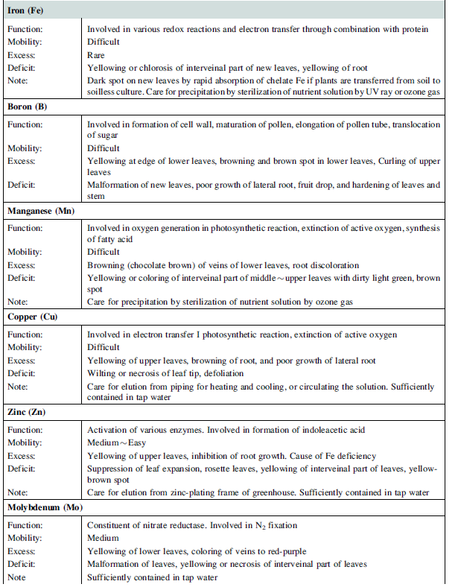

Slide 15
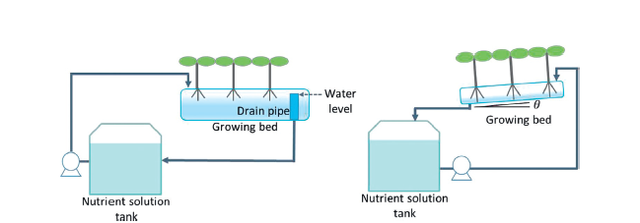
Hydroponics Systems
Nutrient Film Technology
Drain Film Technology

Slide 16
Main crops
Green Leafy Vegetables- Leetuce, Basil, organic herbs etc
Vegetables like Tomato, Garlic, cucumber, egg plant etc
Health Benefits vegetables grown in plant factory
Fiber supports normal bowel movements and helps lower cholesterol levels.
Vitamin K is essential for blood clotting, heart health, and building strong bones.
Vitamins A and C are both antioxidants, which help prevent cell damage from free radicals.
Vitamin A also helps with vision while vitamin C strengthens the immune system and supports healthy skin.
Folate is a key coenzyme to hundreds of metabolic processes and is required for cell division.
Iron is a key component of hemoglobin, which delivers oxygen to tissues. Deficiency can cause anemia

Slide 17
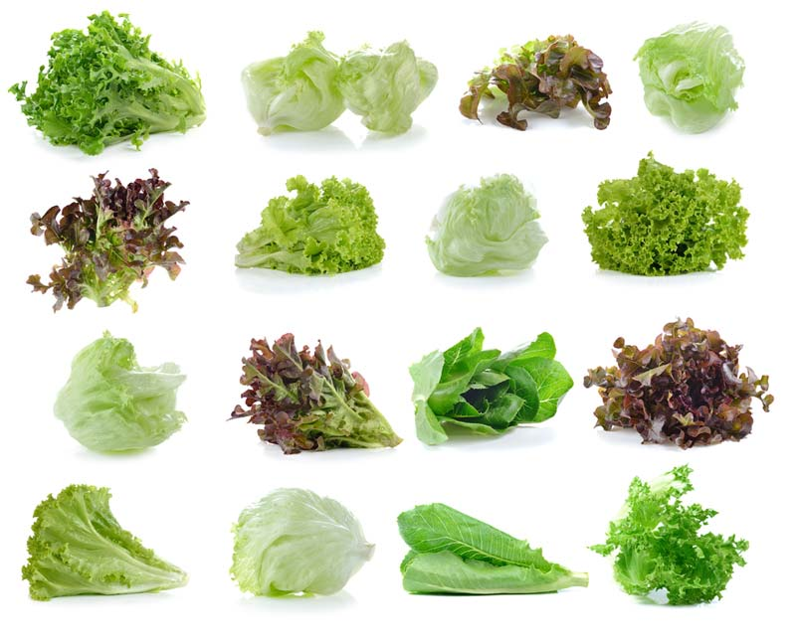
Variety of Green leafy Lettuces

Slide 18
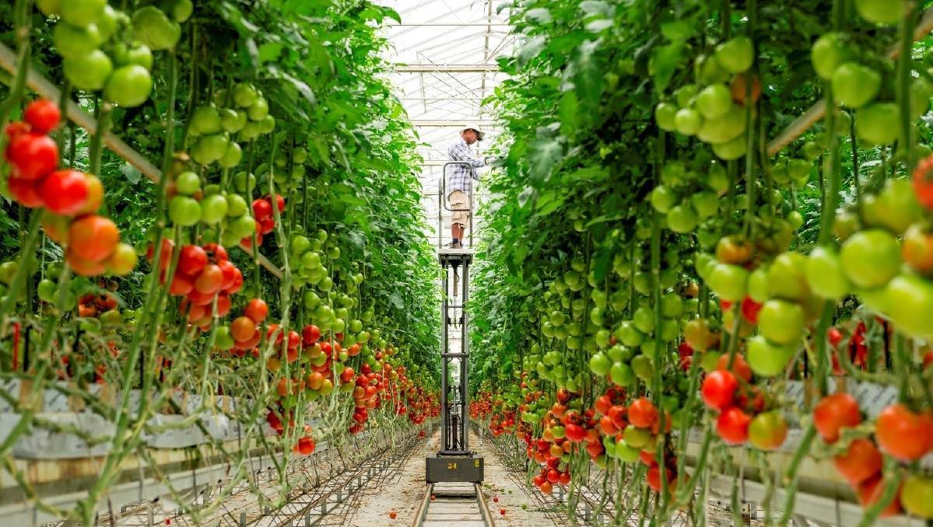
Hydroponics Tomato

Slide 19
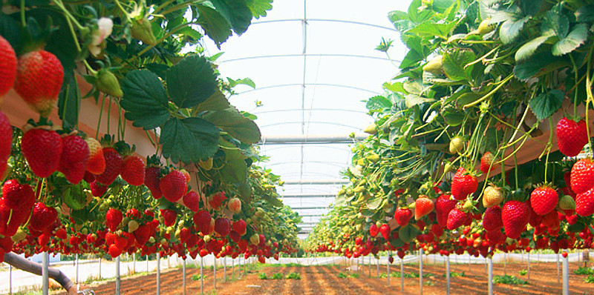
Hydroponics Strawberries

Slide 20
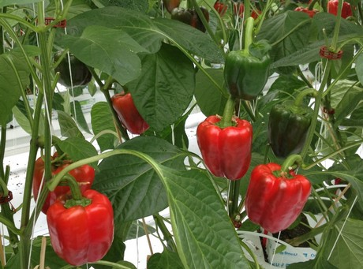
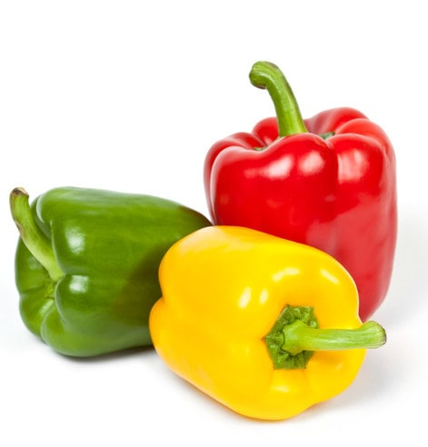
Hydroponics Pepper/Capcicum

Slide 21
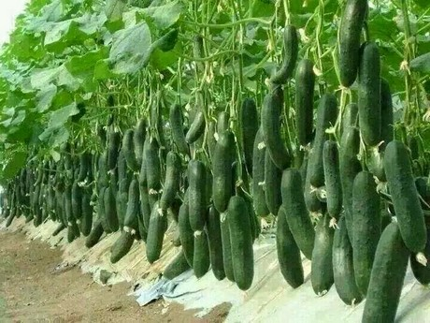
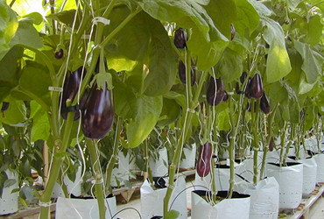
Cucumber and egg plant

Slide 22
ROLES OF PFALs (Plant Factories in artificial Lighting) IN URBAN AREAS
In addition to food production, PFALs as one form of agriculture play environmental, social, and cultural roles, as described in Chapter 2. PFALs are expected to become a key component in urban areas to help alleviate the following local and global issues:
Climate change (global warming), pest insects, and natural disasters (strong wind, rain, flood, drought, etc.), and resultant vulnerabilities of crop yield and quality.
Increasing urban population.
Increasing demands for local production for local consumption to improve food security and safety.
Increasing demands for fresh food, nutritious food, functional food for health care and/or higher quality of life.
Increasing shortages and/or prices of water for irrigation and fossil fuels.
Decreasing population involved in agriculture due to aging of farmers.
Decreasing arable land area due to urbanization, soil contamination, and salt accumulation at soil surface, etc.
Decreasing opportunities for growing plants or producing foods by people living in urban areas.

Slide 23
BENEFITS OF PRODUCING FRESH VEGETABLES USING PFALs IN URBAN AREAS
The benefits of producing fresh vegetables using PFALs in urban areas include:
Compared with field agriculture, over 100 times higher annual productivity per unit land area regardless of weather and season, by the use of multiple tiers, optimal environmental control, minimum loss of plants to pest insects, etc. A large land area is not required for producing fresh foods.
PFALs can be built in shaded and/or unused areas such as an empty space in a building, and even the basement, because neither soil nor sunlight is needed.
The distance between production and consumption sites is minimized, thus reducing fuel consumption, CO2 emissions, and traffic for food transportation.
Citizens can enjoy fresh food at lower prices.
Losses of fresh produce and/or fuel for cooling the produce during transportation are minimized.
Safe, enjoyable, and light-work job opportunities under comfortable environments are created for a wide range of people including elderly and handicapped persons.
Waste water, vegetable waste, and CO2 produced in urban areas can be reused, after proper processing, as essential resources (water, CO2, and fertilizer) for growing plants in PFALs. Waste heat energy can be used for heating greenhouses in winter and for other purposes.
The PFAL can be combined with aquaculture, mushroom culture, and fermentation systems for mutual efficient use of their respective wastes as resources.
Surplus electricity supply at night time compared with daytime can be used.

